Slide 1

ENGINEERING CHEMISTRY
Asha A
Department of Science and Humanities

Slide 2

ENGINEERING CHEMISTRY
Module 1- Molecular spectroscopy
Class Content :
Electromagnetic spectrum
Information obtained from each region of the spectrum

Slide 3
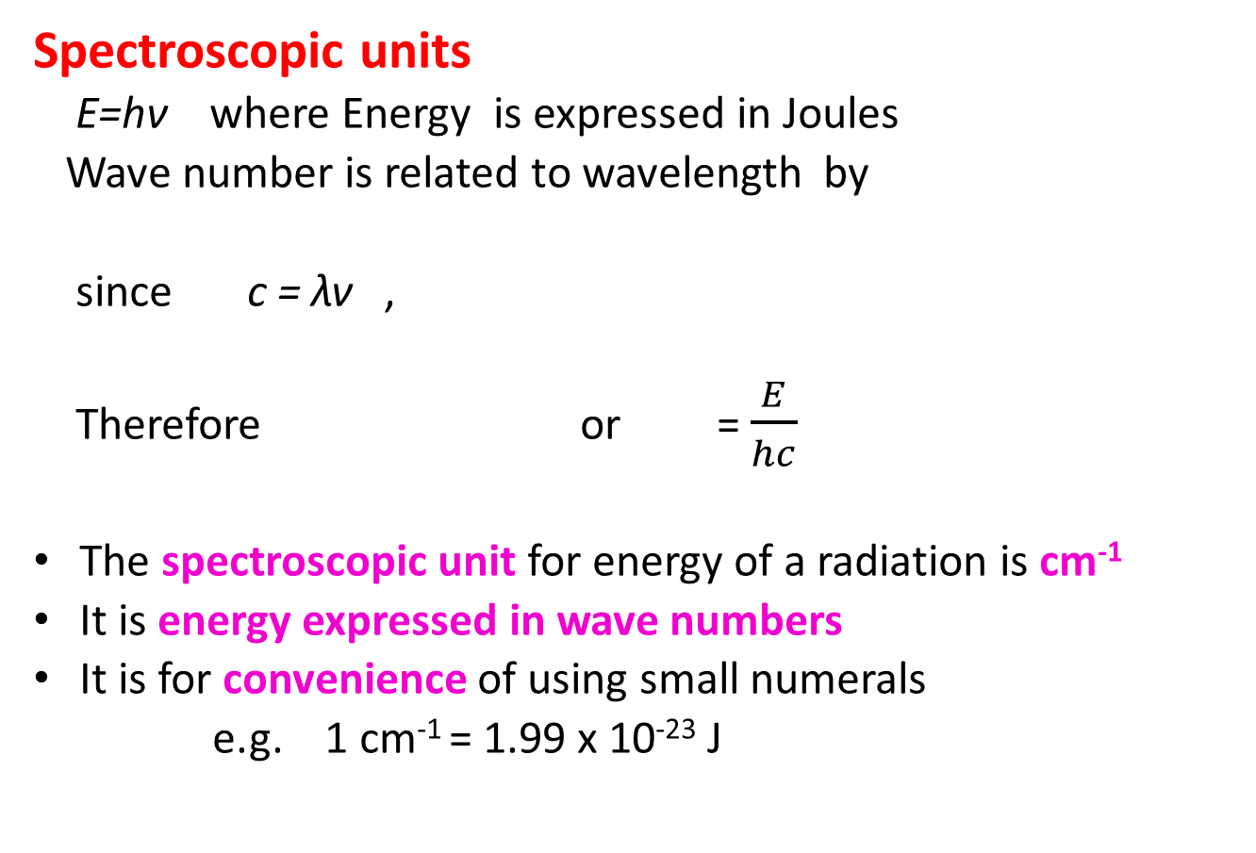
ENGINEERING CHEMISTRY
Module I- Molecular Spectroscopy
Spectroscopic units
E=hν where Energy is expressed in Joules
Wave number is related to wavelength by
since c = λν ,
Therefore or = $\frac{E}{hc}$
The spectroscopic unit for energy of a radiation is cm⁻¹
It is energy expressed in wave numbers
It is for convenience of using small numerals
e.g. 1 cm⁻¹ = 1.99 x 10⁻²³ J

Slide 4
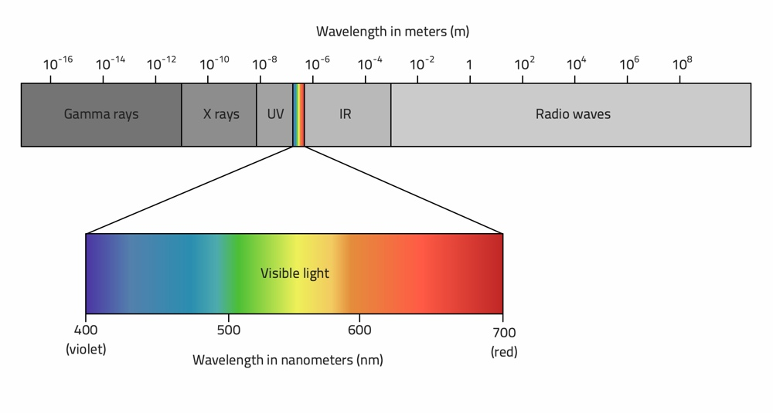
ENGINEERING CHEMISTRY
Module I- Molecular Spectroscopy
Electromagnetic spectrum
Source: https://www.radio2space.com/components-of-electromagnetic-spectrum/

Slide 5
Information obtained from different regions of electromagnetic spectrum
ENGINEERING CHEMISTRY
Module I- Molecular Spectroscopy
Radiofrequency region | Wavelength (10m-1cm) NMR, ESR Nuclear and electron spin reversal
Microwave region | Wavelength (1cm-100µm) Rotational spectroscopy Rotational levels
Infra Red region | Wavelength (100µm-1µm) Vibrational spectroscopy Vibrational levels

Slide 6
Information obtained from different regions of electromagnetic spectrum
ENGINEERING CHEMISTRY
Module I- Molecular Spectroscopy
Visible and Ultra-Violet region | Wavelength (1µm-10nm) UV-Visible spectroscopy Electronic states Change in electronic distribution of valence electrons
X-ray region | Wavelength (10nm-100pm) X-ray spectroscopy Change in electronic distribution of inner electrons
γ- ray region | Wavelength (100pm-1pm) γ- ray spectroscopy Rearrangement of nuclear particles

Slide 7
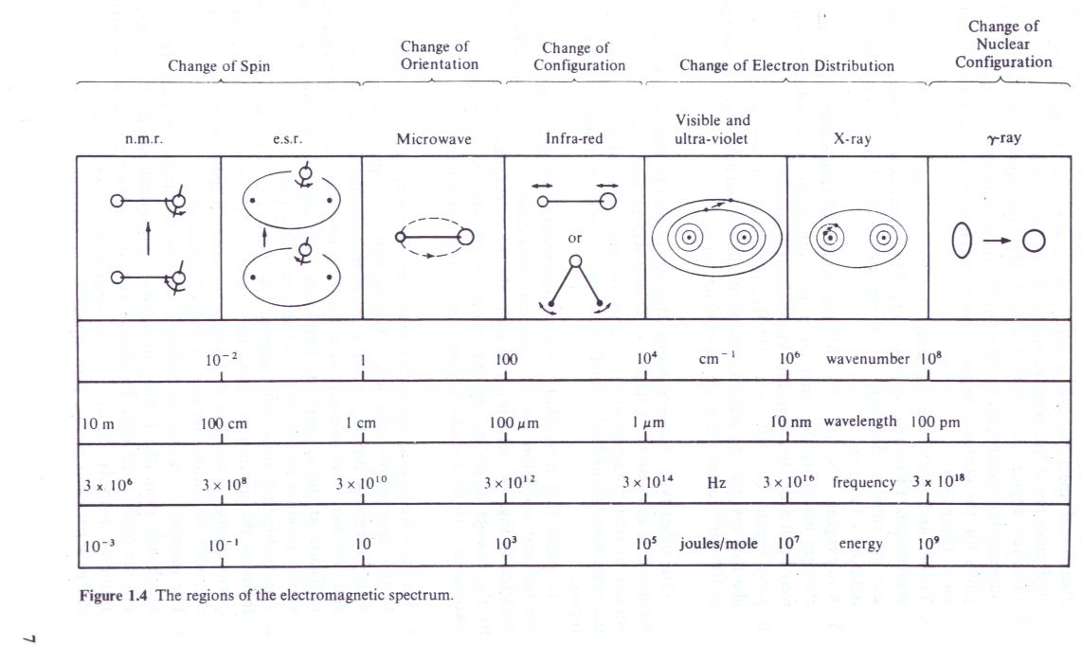

Slide 8
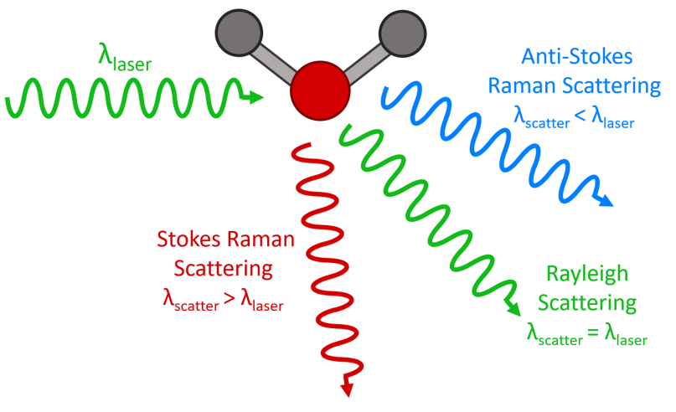
ENGINEERING CHEMISTRY
Module I- Molecular Spectroscopy
Raman Spectroscopy: scattering of light
When monochromatic radiation is passed through a transparent medium:
Most of the scattered radiation consists of radiation of incident wavelength – Rayleigh scattering
Some of the scattered radiation consists of radiation with different wavelength from incident wavelength – Raman scattering
When the wavelength of scattered radiation is more than that of incident radiation – Stokes lines
When the wavelength of scattered radiation is less than that of incident radiation – anti -Stokes lines
https://www.edinst.com/blog/what-is-raman-spectroscopy/

Slide 9
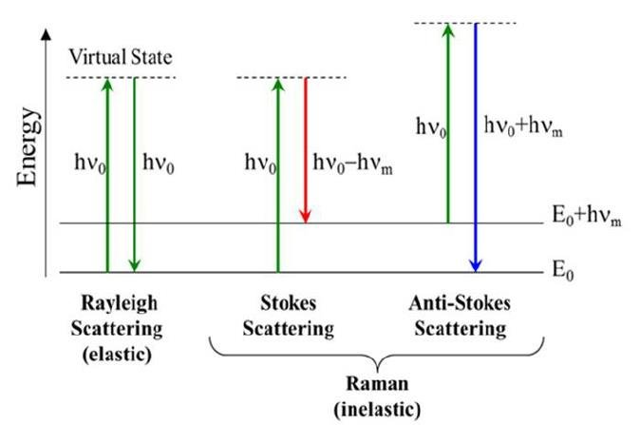
ENGINEERING CHEMISTRY
Module I- Molecular Spectroscopy
Source:https://www.researchgate.net/figure/A-simplified-diagram-of-energy-transitions-for-Rayleigh-and-Raman-scattering_fig7_327321311
Exchange of energy between the molecules and radiation
Homonuclear diatomic molecules which are microwave and Infra-red inactive are Raman active

Slide 10
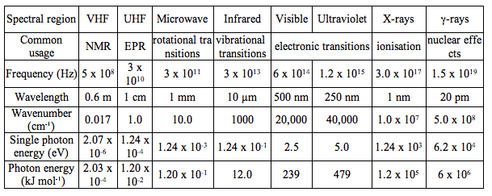
Information obtained from different regions of electromagnetic spectrum
ENGINEERING CHEMISTRY
Module I- Molecular Spectroscopy
Source: http://photobiology.info/Visser-Rolinski.html

Slide 11
THANK YOU
Asha A
Department of Science and Humanities

